Slide 1
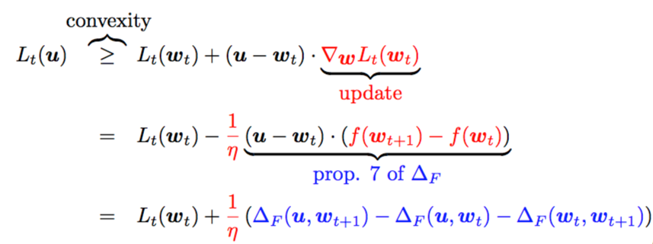
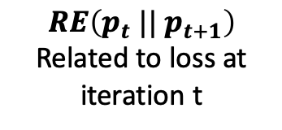





$$RE\left(q |{| p}_{t}\right)$$
$$p_{t}$$
$$q$$
$$RE\left(p_{t} |{| p}_{t+1}\right)$$
Related to loss at iteration t
$$p_{t+1}$$
$$RE\left(q |{| p}_{t+1}\right)$$

